Slide 1
CONTRIBUTION OF URBAN AGRICULTURE IN HOUSEHOLDS POVERTY REDUCTION IN MBEYA CITY: A CASE OF MWAKIBETE WARD
BY
ITIKA ALEX KALIBULE

Slide 2
STATEMENT OF THE PROBLEM
Urban farming and poverty reduction have been the subject of numerous studies including that of Mlozi et al. (2015). The effect of urban farming on reducing poverty (Mlozi et al., 2015) and the influence of urban farming on household economies. According to Mlozi et al. (2015), urban farming has the potential to provide food security and income to urban households. This is especially important for low-income households who cannot afford to buy food from the market. In addition, urban farming can provide employment opportunities for the urban poor. According to Mougeot (2014), urban farming can provide employment opportunities for the urban poor who may not have access to formal employment. Moreover, urban farming can also contribute to the local economy by providing fresh produce to the local market. According to Herweg and Schmitz (2021), urban farming can help reduce the cost of food in the market, thereby making it more affordable for low-income households. As a result, not much is known about how it helps urbanites reduce household poverty. Lack of knowledge regarding whether urban farming is a source of income that reduces or increases inequality may be more significant to the region authority. This study therefore aimed to close this disparity by assessing the contribution of urban farming in poverty reduction in Mwakibete ward.

Slide 3
RESEARCH OBJECTIVES
General objective
To assess the contribution of urban agriculture in household poverty reduction in Mbeya City.
Specific objectives
To examine urban agriculture practices in the study area
To examine income obtained from urban agriculture in the study area.
To determine the environmental concerns related to urban agriculture in the study area

Slide 4
RESEARCH QUESTIONS
Research Questions | Variables
What are the urban agriculture practices in the study area? | Types of crops and livestock Practices for crops and livestock used Yields for crops and livestock kept Marketing from urban agriculture products
What is the income obtained from urban agriculture in the study area? | Income from urban agriculture Income from other sources Expenditure from the income
What are the environmental concerns related to urban agriculture in the study area? | Environmental pollution Availability of space for urban farming Regulations for urban agric.

Slide 5
SIGNIFICANCE OF THE STUDY
The study on the contribution of urban agriculture to household poverty reduction in Mbeya City is significant in many ways. Firstly, poverty is a major global problem that affects many people, and this study seeks to identify a potential solution to this problem. The findings of this study can be used to inform policy decisions that aim to alleviate poverty in urban areas. Secondly, the study provides insight into the role of agriculture in the urban economy. Urban agriculture is a sector that is often overlooked, and this study sheds light on its importance in the livelihoods of urban residents. Thirdly, the study highlights the potential of urban agriculture to improve food security in urban areas. With rising urbanization and increasing food insecurity, urban agriculture can play a crucial role in ensuring that urban residents have access to fresh and healthy food. Finally, the study provides an opportunity to explore the gender dynamics of urban agriculture. Women are often overlooked in agriculture, and this study can provide insights into the role of women in urban agriculture and their contribution to household poverty reduction. Overall, the study on the contribution of urban agriculture to household poverty reduction in Mbeya City is significant in providing insights into poverty reduction, urban agriculture, food security, and gender dynamics.

Slide 6
CONCEPTUAL FRAMEWORK
INDEPENDENT VARIABLES
INTERMEDIATE VARIABLE
DEPENDENT VARIABLE
Types of crops and livestock
Practices for crops and livestock used
Yields for crops and livestock kept
Marketing from urban agriculture products
Income from urban agric. (Crops and Livestock)
Income from other sources (e.g. small business)
Expenditure from the income
Access to financial resources
Availability of space for urban farming
Government policies
National Agricultural policy
Households poverty reduction

Slide 7
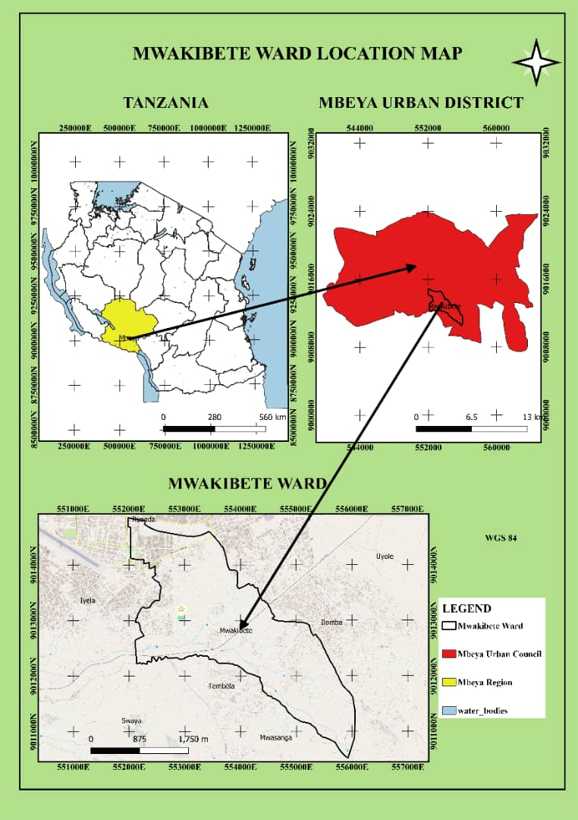
RESEARCH METHODOLOGY
Selection of the Study Area
The study aimed to investigate the role of urban agriculture in reducing poverty in Mbeya city. Mbeya city is selected as the study area due to its high population density and the presence of various economic activities. The study area is also accessible, which makes data collection easier and more efficient (Fig. 2).
Research Design
This study employed a non-experiment cross-section research design. This design allowed the researcher to involve the respondents once during the study. This design is appropriate because it allows the researcher to describe and analyze the urban agriculture in reducing poverty. The study involved collecting data from the selected farmers in Mbeya district who practice urban agriculture.

Slide 8
DATA TYPES AND SOURCES, DATA COLLECTION METHODS & TOOLS
Data Types and Sources | Data collection | tools
Primary( source: individual farmer | interview | questionnaires
Secondary( sources: reports from the government, non-governmental organizations etc. | Documentary review | checklist

Slide 9
SAMPLING
Sampling frame
The sampling frame for this study included all urban farmers of Mwakibete ward who are urban farmers.
3.5.2 Sampling unit
The sampling unit for this study included heads of household farmers who practice urban farming in Mbeya City.
3.5.3 Sampling size
The sample size of 98 respondents from the Mbeya district.
To calculate the sample size, we need to use the following formula:
n = N / (1 + N (e²))
Where:
n = sample size
N = population size
e = margin of error (expressed as a decimal)
Assuming a 90% confidence level and a margin of error of 10%,
So, using the formula:
n = N / (1 + N (e²))
n = 7528 / (1 + 7528 (0.1²))
n = 98
Sampling procedures
The reason for using this sampling procedure is to ensure that the research study obtains a representative sample of urban farming farmers in Mbeya city.

Slide 10
DATA PROCESSING, ANALYSIS AND PRESENTATION
Data Processing
The data collected from the questionnaires were checked for completeness, coded, and entered into a statistical package for social sciences (SPSS) for analysis. The data were cleaned to eliminate any inconsistencies, errors, or missing values. The cleaned data were then be transformed into suitable formats for analysis.
3.6.2 Data Analysis
The data were analyzed using descriptive statistical techniques. Descriptive statistics such as frequencies, percentages, means, and standard deviations were used to summarize the data.
3.6.3 Data Presentation
The findings of the study were presented using tables, charts, and graphs. The results were presented clearly and concisely to facilitate easy understanding. The results were presented according to the research questions and objectives. The researcher used qualitative and quantitative data to support the findings. The researcher also presented the results of the study in the context of the relevant literature reviewed in chapter two of the research proposal.

Slide 11
RESULTS AND DISCUSSION
Years of Experience in Urban Farming
The results showed that 39.8% of respondents have 1-5 years of experience in urban farming, followed by 30.6% with 6-10 years, and 29.6% with over 10 years of experience (Table 1).
Demographic Characteristics of Respondents
Age of the Respondents
The frequency table indicates that the majority of the respondents are within the age group of 18-29 years, accounting for 31.6% of the total sample (Table 1). The second largest group falls within the 30-45 years range, representing 27.6%. Respondents aged 46-55 years make up 22.4%, while those aged 56 years and above constitute the smallest group at 18.4% (Table 1).
Sex of Respondents
The distribution of respondents by sex reveals that males comprise 55.1% of the sample, while females make up 44.9% (Table 1). The near-even distribution suggests a relatively balanced gender participation in urban farming activities.
Marital Status of Respondents
Regarding marital status, 30.6% of respondents are single, 28.6% are married, 21.4% are widows or widowers, and 19.4% are separated (Table 1).
Education Level of Respondents
The education level distribution shows that 29.6% of respondents have an undergraduate degree, followed by 27.6% with primary education (Table 1). Both secondary and college education levels account for 21.4% each as shown on Table 1.
Variable | Description | Responses
 |  | Frequency | Percentage
Sex | Male | 54 | 55.1
 | Female | 44 | 44.9
Age (years) | 18 - 29 | 31 | 31.6
 | 30 - 45 | 27 | 27.6
 | 46 - 55 | 22 | 22.4
 | 56 | 18 | 18.4
Marital status | Single | 30 | 30.6
 | Married | 28 | 28.6
 | Widow/widower | 21 | 21.4
 | Separated | 19 | 19.4
Education level | Primary education | 27 | 27.6
 | Secondary education | 21 | 21.4
 | College education | 21 | 21.4
 | Undergraduate | 29 | 29.6
Years of experience | 1-5 years | 39 | 39.8
 | 6-10 years | 30 | 30.6
 | 10 years above | 29 | 29.6

Slide 12
Urban Agriculture Practices in the Study Area (objective 01)
Types of crops and livestock
The dichotomy group analysis of livestock types kept by the farmers indicates that pigs are the most commonly harvested livestock, accounting for 16.7% of the total responses and 55.7% of the cases (Table 2). Rabbits (15.4%), goats (15.1%), and ducks (14.8%) also represent significant portions, with chickens, cattle, and sheep being less prominent as shown in table 2.
Regarding crops, maize is the most frequently harvested, representing 21.1% of responses and being harvested by 54.7% of respondents (Table 3). Vegetables (20.3%) and fruits (20.7%) follow closely, indicating a preference for diverse crops that can contribute both to household food security and income generation (table 3).
Types of crops harvested |  | Response
 |  | Frequency | Percent (%)
 | Maize | 52 | 21.1
 | Legumes | 44 | 17.9
 | Vegetables | 50 | 20.3
 | Beans | 49 | 19.9
 | Fruits | 51 | 20.7
Total |  | 246 | 100
Types of livestock kept |  | Response
 |  | Frequency | Percent (%)
 | Chickens | 40 | 12.3
 | Ducks | 48 | 14.8
 | Cattle | 44 | 13.6
 | Goats | 49 | 15.1
 | Pigs | 54 | 16.7
 | Sheep | 39 | 12.0
 | Rabbits | 50 | 15.4
Total |  | 324 | 100

Slide 13
Practices for crops and livestock used
The results from the study shows that crop rotation is the most common practice, with 43.9% of respondents employing it (Table 4). The use of fertilizers (35.7%) and irrigation (20.4%) are also notable (Table 4).
For livestock, zero grazing is the most common practice, used by 43.9% of respondents, followed by manure management (35.7%) and veterinary services (20.4%) (Table 4).

Slide 16
RECOMMENDATIONS
CONCLUSIONS
Demographic data of the respondents suggests a predominantly youthful population engaged in urban agriculture, with a significant proportion of participants aged between 18-29 years. This demographic pattern is likely to influence the adoption of innovative agricultural practices, as younger individuals tend to be more adaptable and open to new methods.
The gender distribution In urban agriculture reveals a nearly balanced participation between males and females, although a slight male dominance is observed. This gender balance suggests that urban farming is an inclusive activity, though traditional gender roles may still play a part in the dynamics of participation.
In farming practices, the data indicates a wide range of involvement levels, with moderate participation being the most common. Specific practices such as crop rotation and zero grazing are prevalent, reflecting a commitment to sustainable farming methods among respondents. Moreover, the marketing strategies employed, including home delivery services, suggest an adaptation to the urban context, where convenience and direct consumer engagement are prioritized to meet the demands of the urban market .
Programs aimed at introducing and training younger farmers in advanced agricultural practices, such as precision farming, hydroponics, and vertical gardening, could significantly enhance productivity and sustainability.
The balanced gender participation in urban agriculture, though slightly skewed towards males, presents an opportunity to foster inclusivity and equity within this sector.
Given the commitment to sustainable practices like crop rotation and zero grazing, and the adaptation to urban market demands through marketing strategies such as home delivery services, it is recommended to further promote these practices.

